Slide 1
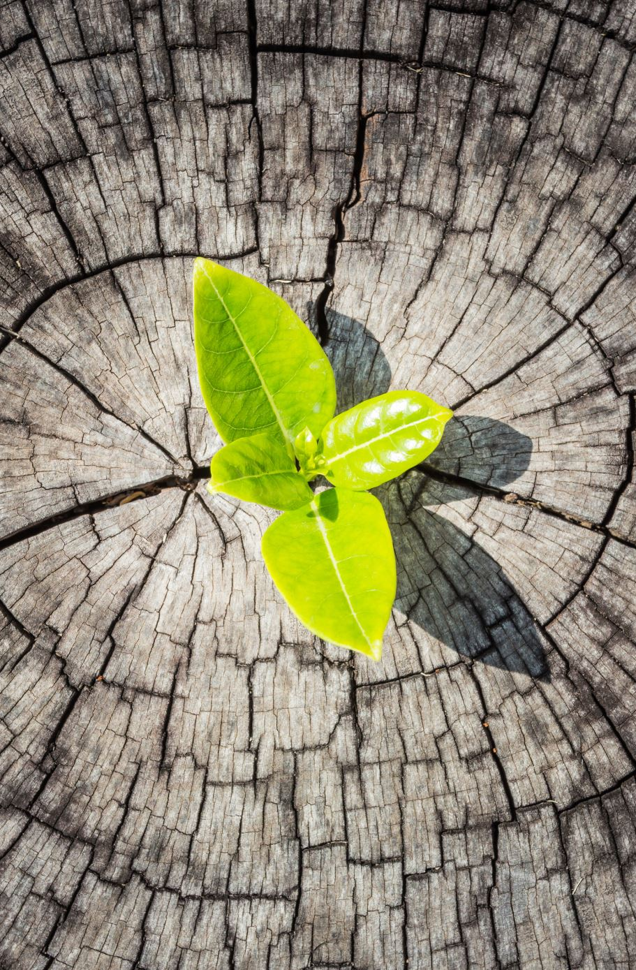
Plant Disease Prediction
TEAM
Satrajit Sahu-12529285
Dany Vikram-12525787
Avinash - 12529188
Sai Koti - 12509121

Slide 2
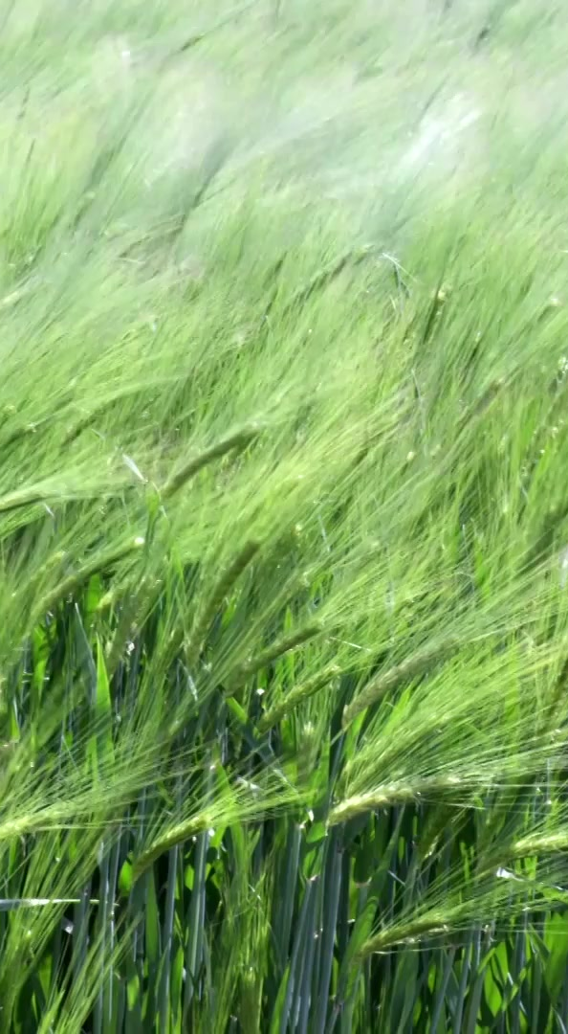
Introduction
Importance of agriculture
Role in economy
Impact of diseases
Description: Agriculture plays a very important role in our daily lives as it provides food and employment. In countries like India, many people depend on farming for their livelihood. However, plant diseases are a major problem that affects crop production. These diseases reduce both the quality and quantity of crops. Farmers often struggle to identify diseases early, which leads to losses. With the help of new technologies like artificial intelligence, we can improve the process of disease detection and support farmers in increasing their productivity.

Slide 3
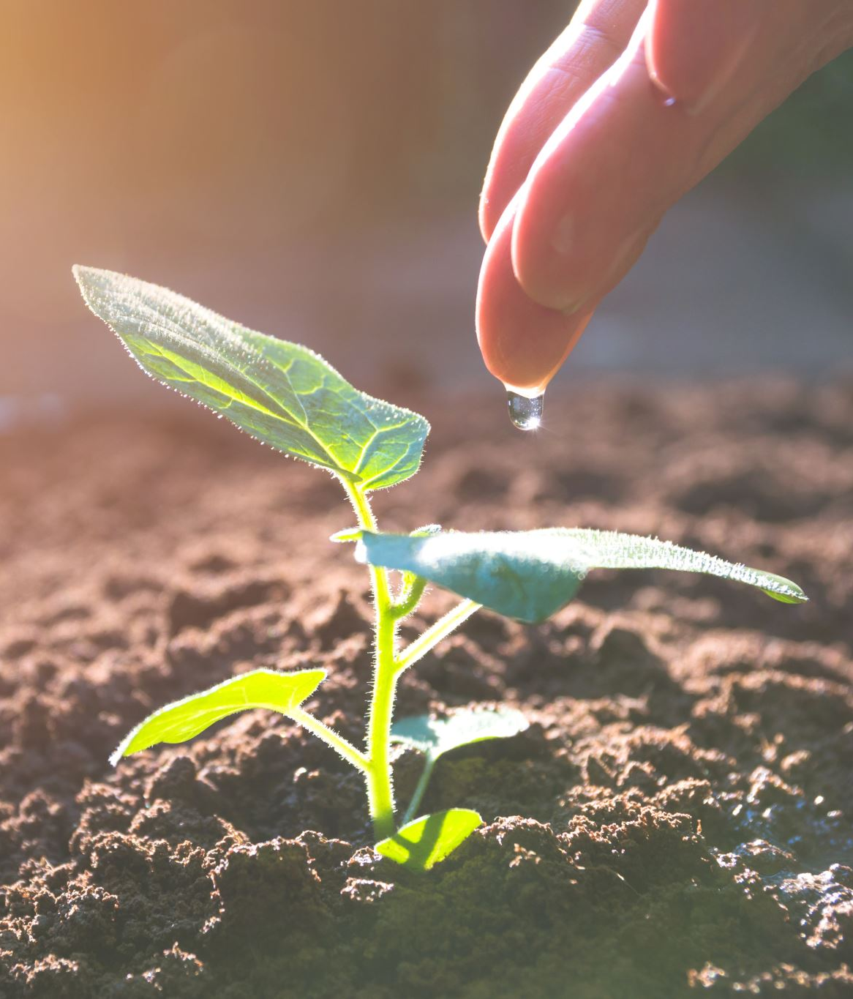
Problem Statement
Manual detection
Lack of experts
Time-consuming
Description: Traditionally, farmers identify plant diseases by observing leaves with the naked eye. This method is not always reliable because many diseases look similar. It also takes time and requires experience. In many rural areas, expert help is not easily available. Because of this, farmers may not detect diseases at the right time, which leads to crop damage. So, there is a need for an automated system that can quickly and accurately detect plant diseases without depending on human expertise.

Slide 4
Objectives
Automate detection
Improve accuracy
Provide cause & cure
The main goal of our project is to create an automated system for detecting plant diseases. We want to use deep learning techniques to improve accuracy and reduce human effort. Another important objective is to provide useful information such as the cause of the disease and how to treat it. We also aim to design the system in a simple way so that farmers can use it easily. Overall, our goal is to help farmers identify problems early and improve crop yield.

Slide 5
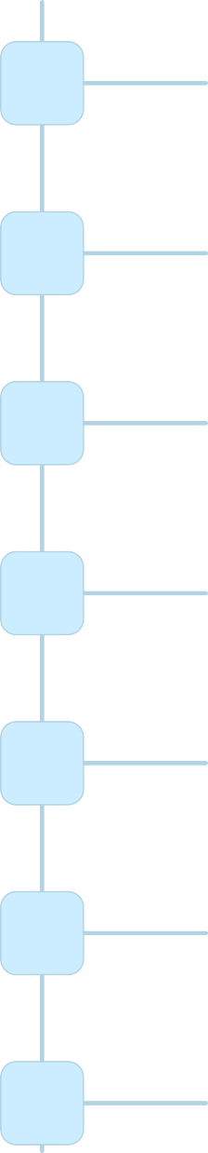
Proposed System
1
Farmers capture high-resolution images of their crops using smartphones
2
Images undergo pre-processing, including resizing, normalization and augmentation to enhance accuracy.
Image segmentation techniques, like K-means clustering, isolate key regions relevant to disease identification.
3
4
Features specific to disease detection, such as leaf color and shape, are extracted from the segme images.
5
The pre-trained CNN model analyzes these features to predict the likelihood of disease infection.
6
The model's predictions and recommendations are presented in a user-friendly web application for farmers.
7
IoT devices provide real-time data for monitoring crop health and feedback loops to improve the system's accuracy.

Slide 6
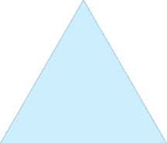



Proposed Methodology
Data Collection
Gather images of healthy and diseased crops, including various
1
diseases and crop types. Public datasets or farm-specific data can be utilized.
Image Pre-processing
Resize, normalize, and augment images to improve model generalization and enhance the dataset.
2
Model Training
Train the model on labelled data using the Adam optimizer and Categorical Cross-Entropy loss function.
Monitor metrics like accuracy and F1-score.
Model Evaluation
Test the model on a validation set to ensure its generalizability to new data. Fine-tune hyper parameters for optimal performance.
3
4

Slide 7
System Overview
Input
Processing
Output
The system works in three main steps. First, the user provides input in the form of a plant leaf image. Second, the system processes the image using preprocessing techniques and analyzes it using a trained model. Finally, the output is displayed, which includes the disease name and its details. This simple flow ensures that the system works efficiently and provides quick results to the user.

Slide 8
Technologies Used
Python
TensorFlow
OpenCV
JSON
We used different technologies to build this system. Python is the main programming language because it is easy to use and powerful. TensorFlow and Keras are used to create and train the deep learning model. OpenCV helps in image processing tasks like resizing and cleaning images. JSON is used to store disease information such as cause and cure. These tools work together to make the system accurate and efficient.

Slide 9
Dataset
PlantVillage dataset
Labeled images
We used the PlantVillage dataset for training our model. This dataset contains thousands of images of plant leaves, including both healthy and diseased samples. Each image is labeled with the correct disease name. This helps the model learn and recognize patterns effectively. A good dataset is very important because it directly affects the accuracy of the system. Using this dataset helped us achieve better results.

Slide 10
Data Preprocessing
Resize
Normalize
Noise removal
Before using images for training, we perform preprocessing. First, we resize images so that all inputs are of the same size. Then, we normalize the pixel values to improve model performance. We also remove noise to make the images clearer. These steps help the model learn better and improve accuracy. Preprocessing is an important step in any deep learning project.

Slide 11

Deep Learning Model
CNN
Image classification
We use a Convolutional Neural Network, also known as CNN, for our project. CNN is very effective for image classification tasks. It can automatically detect patterns in images, such as shapes and textures. This makes it suitable for identifying plant diseases. The model learns from training data and improves over time, making predictions more accurate.

Slide 12
CNN Layers
Convolution
Pooling
Fully connected
The CNN model has different layers that work together. The convolution layer extracts features from images. The pooling layer reduces the size of the data to make processing faster. The fully connected layer uses these features to classify the image. Each layer plays an important role in making accurate predictions.

Slide 13
Working Flow
Upload
Process
Predict
Output
The system follows a simple flow. First, the user uploads an image. Then the system processes it and sends it to the CNN model. The model predicts the disease and retrieves additional information. Finally, the result is displayed to the user. This step-by-step process ensures smooth operation.

Slide 14
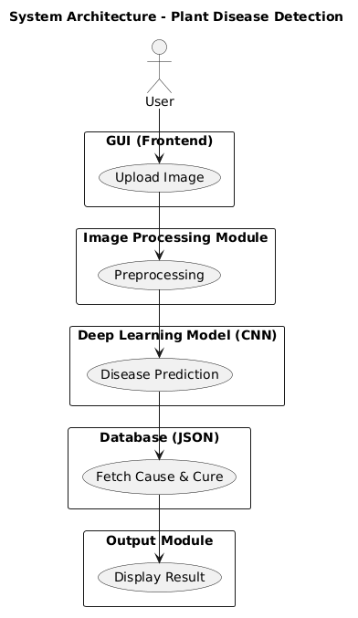
System Architecture

Slide 15
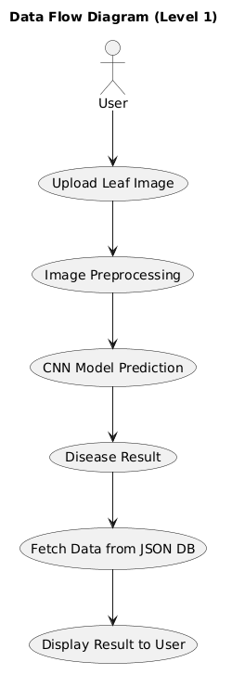
Data Flow Diagram

Slide 16
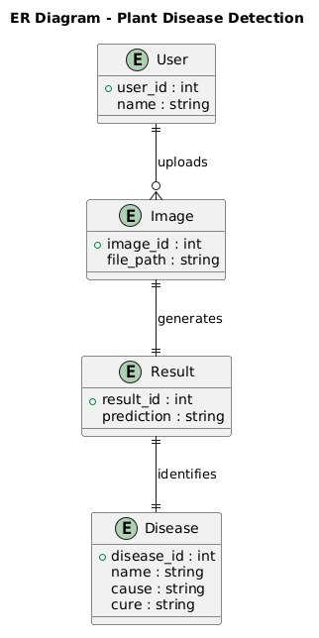
ER Diagram

Slide 17
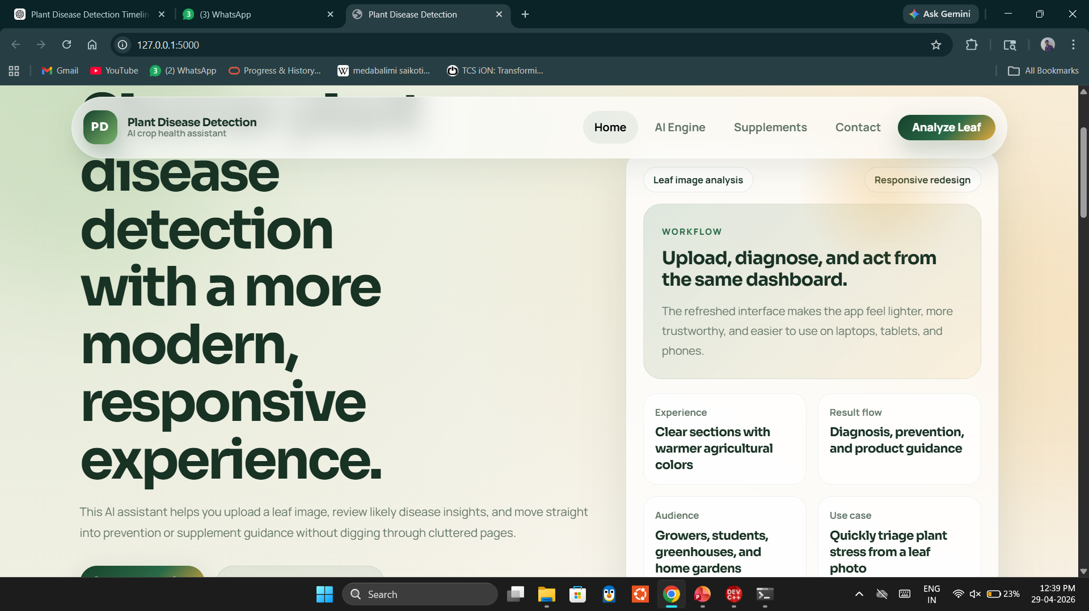
GUI Screens

Slide 18
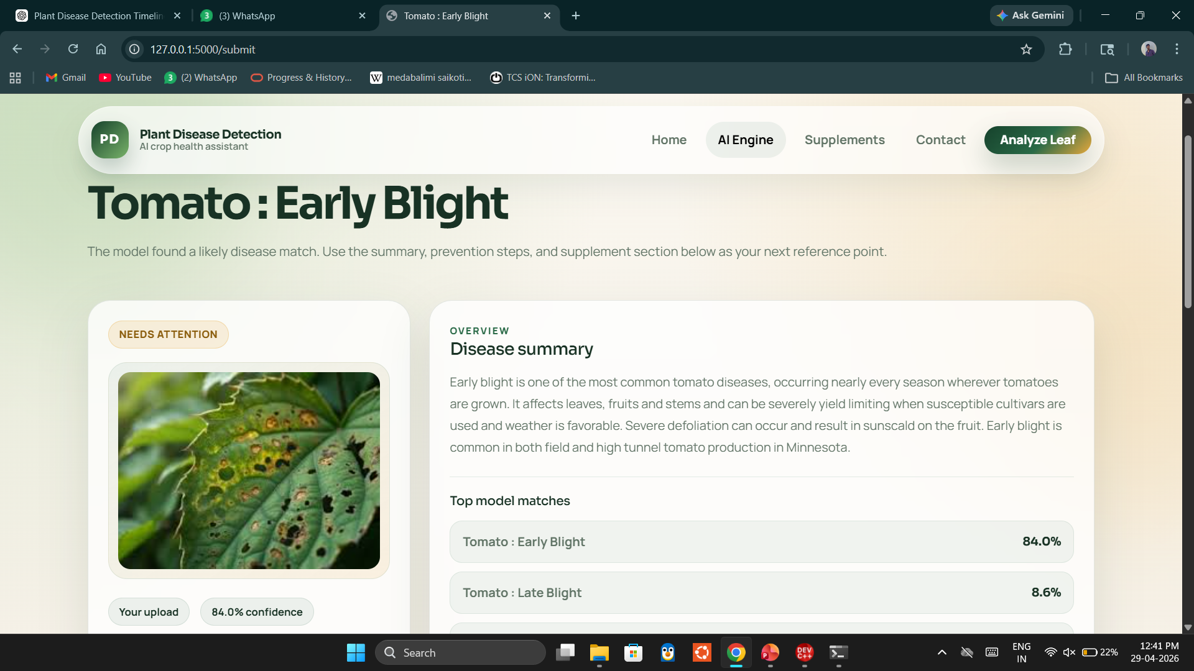
Output

Slide 19
Advantages
Fast processing
High accuracy
Easy to use
Reduces manual effort
Early disease detection
Cost-effective solution
The proposed system offers several important advantages in agricultural applications. It provides fast processing, allowing users to get results within seconds after uploading an image. The use of deep learning ensures high accuracy in disease detection compared to traditional methods. The system is designed with a simple and user-friendly interface, making it easy for farmers to use without technical knowledge. It significantly reduces manual effort and dependency on experts. Early detection of plant diseases helps prevent crop damage and improves yield. Additionally, it is a cost-effective solution that can support farmers in making better decisions and increasing productivity.

Slide 20
Limitations & Future Scope
Requires good quality images
Limited to trained dataset
Cannot detect unknown diseases
Accuracy depends on data quality
Needs internet/system support
Future Scope:
Mobile application development
Real-time detection using camera
Integration with IoT devices
Expansion of dataset
Cloud-based system

Slide 21
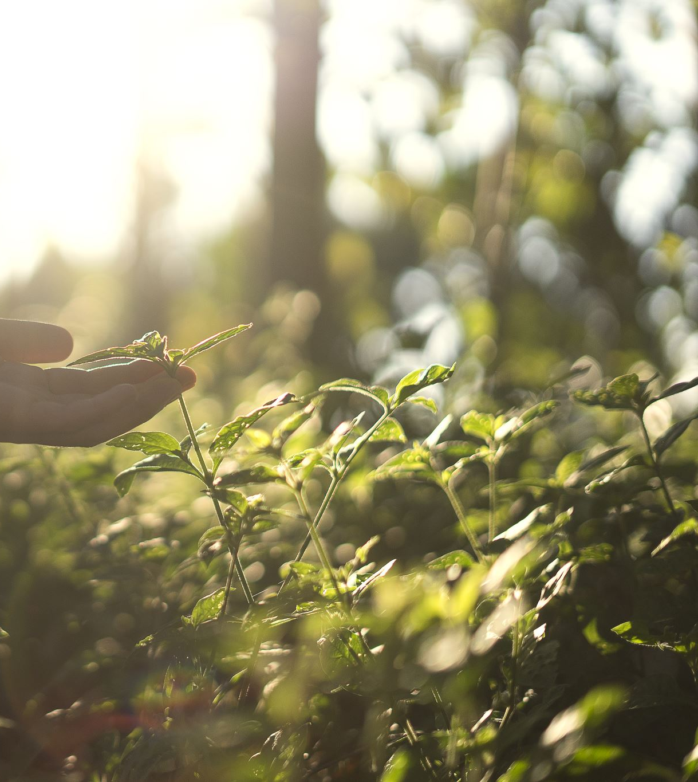
Conclusion
Successful implementation
Accurate disease detection
Supports farmers
Reduces crop loss
Improves productivity
Uses modern AI technology
In conclusion, the Plant Disease Detection System successfully demonstrates the use of deep learning in agriculture. The system is capable of accurately detecting plant diseases from leaf images and providing useful information such as cause and cure. It helps farmers identify problems at an early stage, reducing crop loss and improving productivity. The integration of artificial intelligence makes the system efficient, reliable, and easy to use. This project highlights the importance of technology in solving real-world agricultural problems and shows how AI can contribute to sustainable farming and better decision-making.

Slide 22
THANK YOU

